Slide 1
SDLC MODELS
Adam Gilbert, Harrison Cook, Vignesh Sekar, Kyle Jones

Slide 2
Models:
Spiral Model
V-Shaped Model
Rapid Prototyping
Iterative and Incremental

Slide 3
Spiral Model
Iterative approach to the SDLC
Made up of four phases
Often used for large software projects >6 months time
Primary development strategy in gaming industry
Helps meet constantly changing requirements
Helps create minimum risk
Allows customer to view product as it is being created

Slide 4
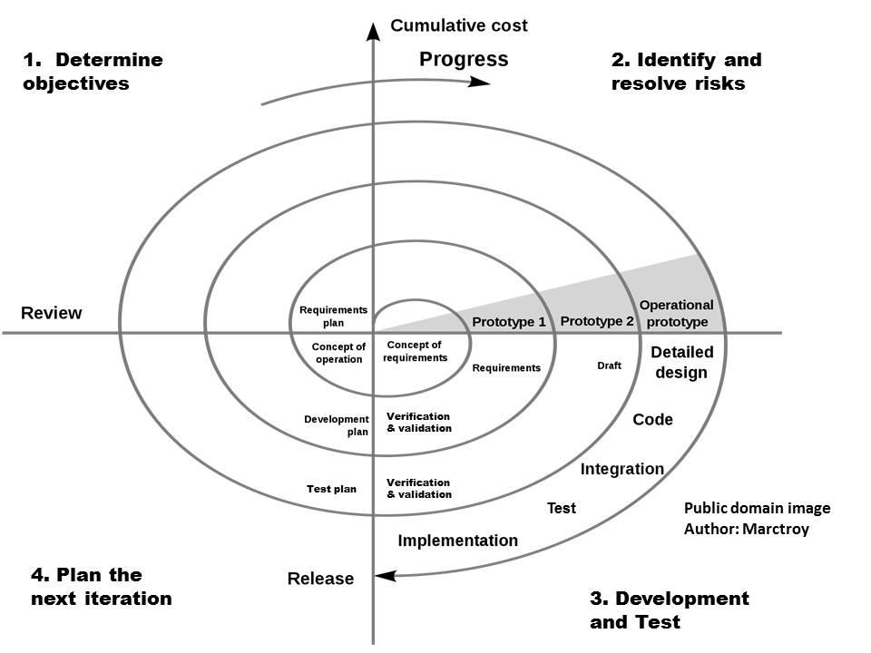
Four Phases of Spiral Model
Determine objectives
Create detailed requirements
Check for re-usability
Check project idea with limitations
Identify and resolve risks
Check methods, experience, and other risks
Check alternative methods
Solve risks; may require reviewing
Development and Test
Create prototype
Review design, code, inspect, test
Plan the next iteration
Review the prototype
Create requirements for next cycle
Begin designing next prototype
*Source: http://ultimatesdlc.com/spiral-model/

Slide 5
Spiral Model Pros and Cons
Pros | Cons
Changing requirements can be accommodated. Allows for extensive use of prototypes Requirements can be captured more accurately. Users see the system early. Development can be divided into smaller parts and more risky parts can be developed earlier which helps better risk management. | Management is more complex. End of project may not be known early. Not suitable for small or low risk projects and could be expensive for small projects. Process is complex Spiral may go indefinitely. Large number of intermediate stages requires excessive documentation.
Source of List: http://www.tutorialspoint.com/sdlc/sdlc_spiral_model.htm

Slide 6
V-Shaped Model
Based on the waterfall model
Requires testing after each phase of development
As a result, the next phase cannot begin until the previous development and test phases are finished.
Each process is segmented, making it very useful for smaller projects
Meant for projects where the requirements are understood from the beginning.
Credit due to Tutorialspoint.com
http://www.tutorialspoint.com/sdlc/sdlc_v_model.htm

Slide 7
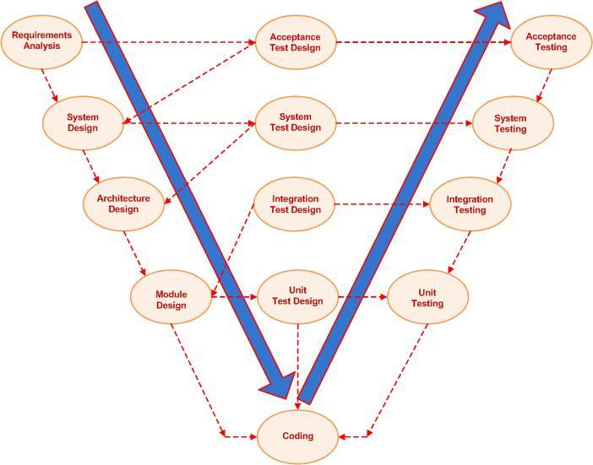
V-Shaped Model Phases
Verification Phases
Requirements analysis
System Design
Architecture Design
Model Design
Coding Phase
Validation Phases
Unit Testing
Integration Testing
System Testing
Acceptance Testing
*Image courtesy of Wikipedia.com

Slide 8
V-Shaped Model Verification Phases
Requirements analysis
Software requirements are collected and figured out in order to meet the customer’s needs
System design
Phase where the software specifications are discussed and recorded in documentation
Architecture design
High Level Design. Different technical approaches are discussed and compared in order to find the best way to build the software.
Module design
Low Level Design. Specific internal design phase where the methods used in the software are created. Augmented by frequent unit tests.

Slide 9
V-Shaped Model Validation Phases
Unit Testing
Test individual methods and other small parts of the written code.
Integration Testing
Methods and code are brought together and tested in order to determine any conflictions
System Testing
The project is tested against the specifications detailed within the system design phase
Acceptance Testing
The product is tested against the requirements of the customer that are solidified in the requirements analysis phase
Credit due to Waterfall-Model.com
http://www.waterfall-model.com/v-model-waterfall-model/

Slide 10
V-Shaped Model Pros and Cons
Advantages
Each phase is clearly outlined and finished one at a time.
Not difficult to understand and apply.
Best used for small projects. Especially where the requirements are known.
Easy to manage across the whole project due to clearly defined stages and tests.
Disadvantages
Does not adapt well with uncertainties.
Does not work well for long, complex, or object-oriented projects
Very rigid and not susceptible changes.
Very difficult to backtrack to an earlier phase.
No prototypes until late in the development cycle
Credit due to Tutorialspoint.com
http://www.tutorialspoint.com/sdlc/sdlc_v_model.htm

Slide 11
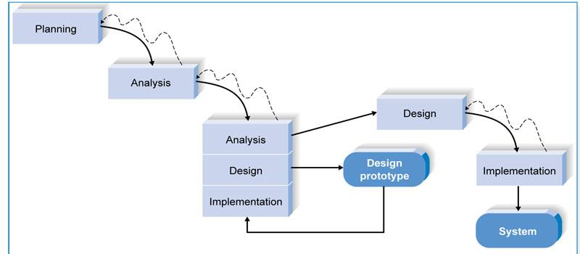
Rapid Prototyping
Source:http://www.ecomval.gov.ph/IDforSAD/interactions/throwaway.html
Good for use with projects where some aspects are not fully understood.
The initial design phase is used in order to create a prototype of specific features of the project in order to show the client.
The feedback from these prototypes are then analysed and used in order to actually design the project now that the originally unknown aspects are understood better.

Slide 12
Rapid Prototyping
Pros:
It is significantly more cost effective than a traditional system when requirements could be changed or are not well defined because these issues are found and solved earlier in the development steps.
Helps with getting a client involved with the creation process so that they are not surprised when the end result is shown to them.
Cons:
This approach can lead to a loss of focus on the whole project, with workers instead focusing solely on analysis of the prototypes and not how those prototypes correspond with the project altogether
There may be confusion on the client side based on thinking the prototype is how the final project will look. Since the prototype is made solely to give the client a feel for how something should work, the prototype and the final work may end up looking completely different.
Forgetting the “rapid” part of rapid prototyping. Prototypes must be put out quickly in order to be effective.
Source:http://en.wikipedia.org/wiki/Software_prototyping#Throwaway_prototyping
http://programmers.stackexchange.com/questions/109409/what-are-the-differences-between-throwaway-and-evolutionary-prototypes

Slide 13
Iterative and Incremental Model
Combinations of the iterative method and incremental build model are most often used today rather than each separately
Iterative method: a continuous process of analyzing, testing, and refining a product
Incremental build model: The model or product is designed, tested, and refined one step at a time and incremented when ready

Slide 14
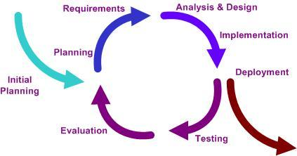
Iterative and Incremental Model
Modeled around a gradual increase in addons (incremental) and a cyclical release and upgrade pattern (iterative)
Consists of four phases, each having 1 or more iterations
Source: http://en.wikipedia.org/wiki/Iterative_and_incremental_development
http://en.wikipedia.org/wiki/Iterative_and_incremental_development

Slide 15
I & I Phases
Iterative and incremental development can be grouped into the following phases:
Inception Phase: Deals with the scope of the project, requirements and risks at higher levels
Elaboration Phase: Delivers working architecture that moderates risks identified in the inception phase and satisfies nonfunctional requirements
Construction Phase: Fills in architecture components incrementally with production-ready code, which is produced through the analysis, implementation, design and testing of functional requirements
Transition Phase: Delivers the system to the production operating environment
Source: http://www.techopedia.com/definition/25895/iterative-and-incremental-development

Slide 16
I & I Pros and Cons
The following table lists out the pros and cons of Iterative and Incremental SDLC Model:
Pros | Cons
Some working functionality can be developed quickly and early in the life cycle. Results are obtained early and periodically. Parallel development can be planned. Progress can be measured. Less costly to change the scope/requirements. Testing and debugging during smaller iteration is easy. Risks are identified and resolved during iteration; and each iteration is an easily managed milestone. Easier to manage risk - High risk part is done first. With every increment operational product is delivered. Issues, challenges & risks identified from each increment can be utilized/applied to the next increment. Risk analysis is better. | More resources may be required. Although cost of change is lesser but it is not very suitable for changing requirements. More management attention is required. System architecture or design issues may arise because not all requirements are gathered in the beginning of the entire life cycle. Defining increments may require definition of the complete system. Not suitable for smaller projects. Management complexity is more. End of project may not be known which is a risk. Source: http://www.tutorialspoint.com/sdlc/sdlc_iterative_model.htm

